Slide 1

Introduction
Methodology
EXPLORING THE PREFERABLE KEYBOARD
TO DESIGN THE CHAM FONTS FOR
WINDOWN AND MACINTOSH
Experiment
Result
bhs c.f\
Bahasa
Melayu Campa
bhs c.f\
Conclusion
bhs c.f\
Ph.D. Mohamad Budi
Prof.Dr. Mohamad Bin Bilal Ali
Dr. Noor Dayana Abd Halim
Thanks

Slide 2
INTRODUCTION
Champa was established in the 2nd century in central Vietnam. (Coedes, 1939). The Melayu Champa is indigenous people of the Champa kingdom.
The Cham people who are now the ethnic minority in Vietnam.
Cham language is a group of Austronesian. Therefore Cham language is close relationship with Malay language(Coedes, 1939; Lafont, 2011).
Cham Script inscriptions appear on Dong Yen Chau stone stele (Tra Kieu) in 4th century and the Cham are using this script system until today. (Lafont, 2011)
Next

Slide 3
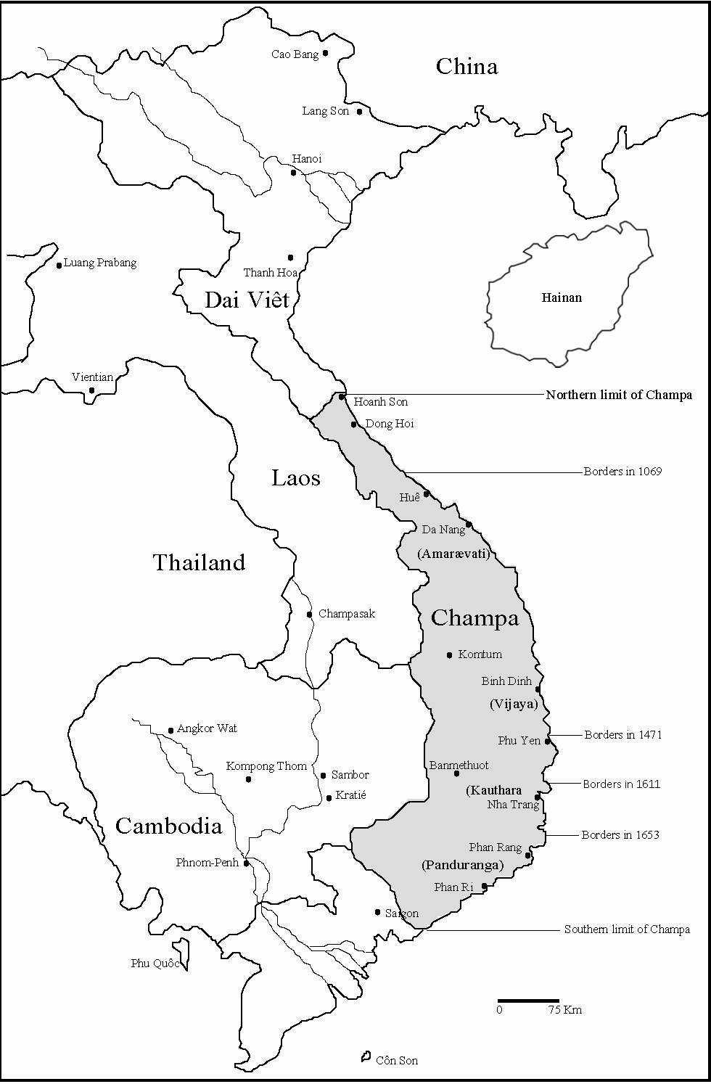
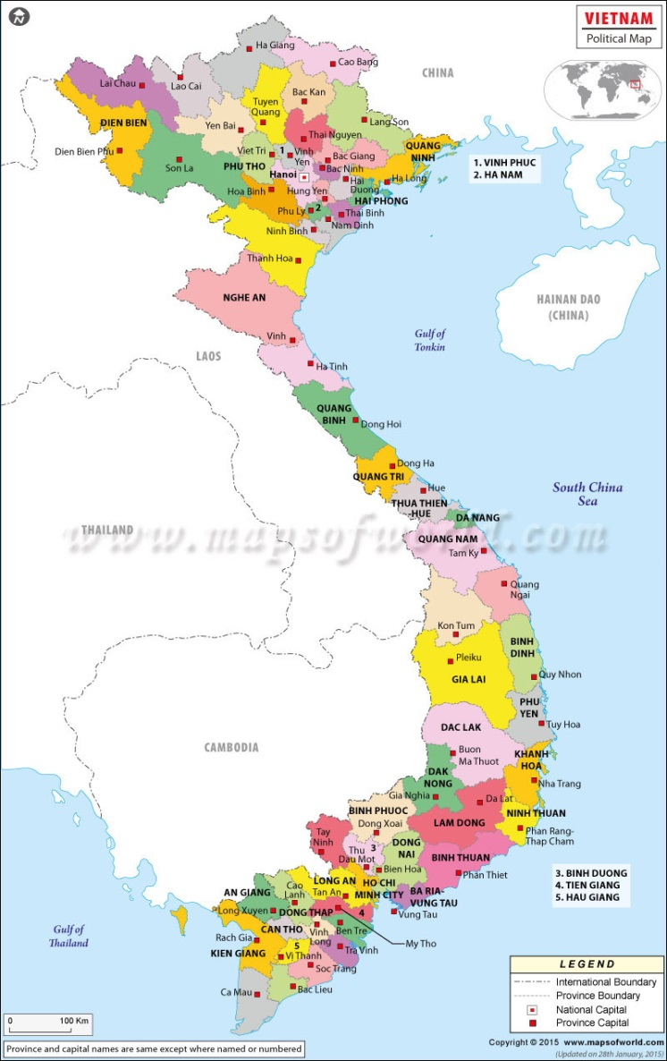
CHAMPA AND DAI VIET
Sources: Danny Wong Tze Ken, The Nguyen and Champa during 17th and 18th Century: A Study of Nguyen Foreign Relations, Paris-San Jose: International Office of Champa (IOC-Champa), Champaka, Monograph 5, 2007, p.192
Pre-
Next

Slide 4
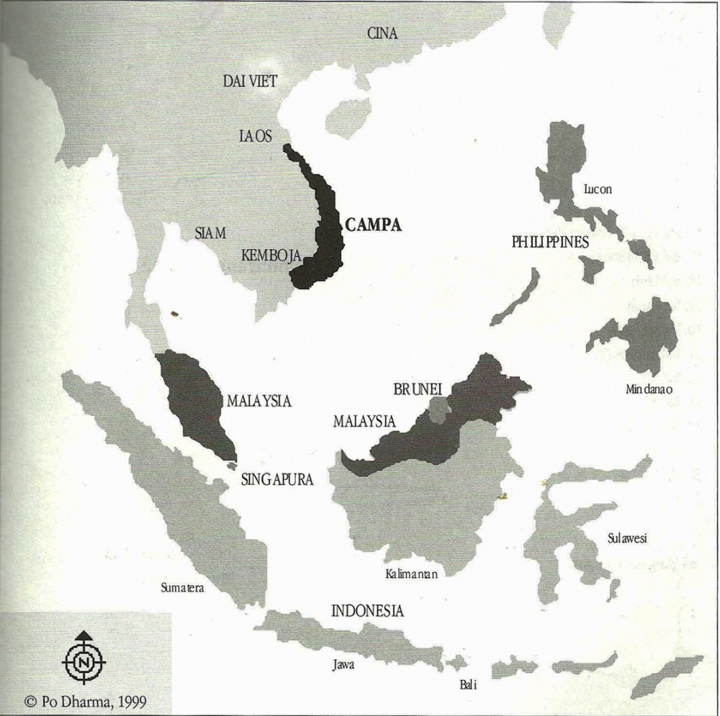
CHAMPA AND THE MALAY WORLD
Sources: G.Moussay and Duong Tan Thi, Peribahasa Cam-Dictons and Proverbes Cam.
Kuala Lumpur: Kementerian Kebudayaan, Kesenian dan Pelancongan Malaysia & EFEO, 2002, p.13
Pre-
Next

Slide 5
LITERATURE REVIEW
The Cham script was systems from the Sanskrit alphabet in southern India.
Cham people have used Indian Sanskrit and then they have improved this Sanskrit completely and become the Cham script.
In Vietnam, some organizations and individuals have created a number of Cham fonts to support for compilation of Cham documents.
These Cham fonts are designed on Unicode standard; however assigning characters (code points) to represent a character or diacritics of Cham language is slightly different.
This is disadvantages for using and storage of Cham documents.
Pre-
Next

Slide 6
OBJECTIVE
For this research, we propose a solutions to survey the keyboard platform and design Cham fonts for Windows and Macintosh.
Research questions are as follows:
  What is the choice of platform that should be created for Cham fonts?
  What is the level acceptance of the Cham font in term of use, convenience, and quality?
Back
Pre-

Slide 7
METHODOLOGY
Research was implemented using a quantitative and the application was developed using ADDIE model.
Cham Font Analysis
The total numbers of Akhar Thrah characters: 86
Removing some duplicated characters, such as H, i, o, and r, respectively (H and 1)= “1”, (i and 3)= “3”, (o and 5)= “5”, (r and 6)= “r”.
The total number of characters that needed to be designed: 82
Next

Slide 8
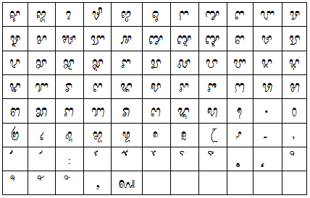
Table 1. Total Cham font characters to create
Pre-
Next

Slide 9
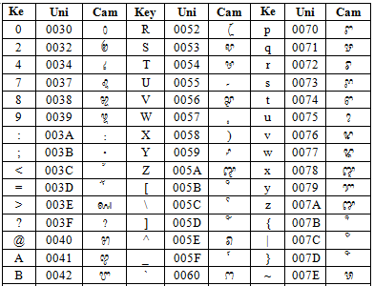
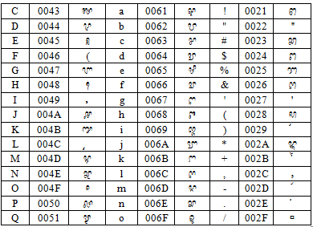
Cham Font Design
Number of characters are designed: 82.
Added seven new punctuation characters: ‘, “, :, •, ?, (, ).
Total number of characters that needed to be designed was 90
Table 2. Code point values ​​corresponding to each Cham script character
Pre-
Next

Slide 10
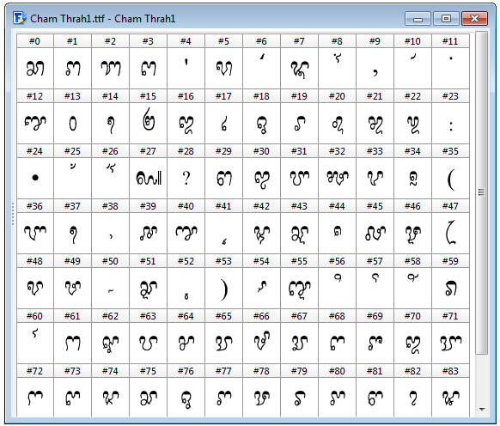
Cham Font Development
These fonts designed based on Cham dictionary and Unicode.
Three Cham fonts: EFEO Panrang, EFEO Panrik, and EFEO Udong.
Typeface of EFEO Panrang is designed based on Moussay’s Cham-Vietnamese-French dictionary.
Figure 1: Code point location of EFEO Panrang
Pre-
Next

Slide 11
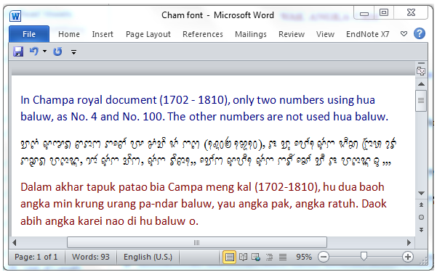
The Times New Roman and EFEO Panrang in Microsoft Word document
Back
Pre-
Figure 2: Times New Roman and EFEO Panrang in MS Word document

Slide 12
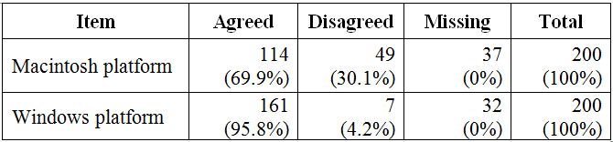
EXPERIMENTS
Exploring the Preferable Keyboard Platform
RQ: What is the choice of platform that should be created for Cham fonts?
Table 3. Choice of keyboard platform via online questionnaire
Next

Slide 13
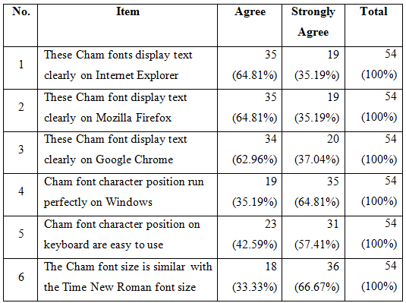
EXPERIMENTS (cont.)
    Acceptance Level from Respondents
Table 4: The level acceptance of new Cham font
Pre-
Next

Slide 14
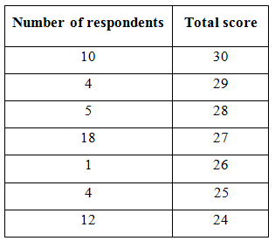
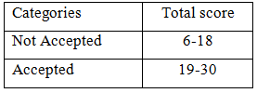
EXPERIMENTS (cont.)
Table 5.8: Number of respondents and total score for Cham font
Table 5.9: Categories of total score for Cham font
Based on Table 5.8 and Table 5.9, it can be concluded that all 54 respondents (100%) accepted the new Cham font.
Pre-
Next

Slide 15
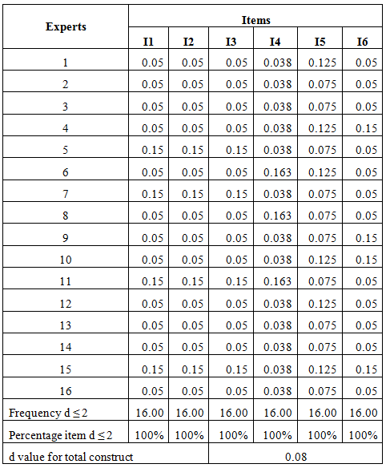
EXPERIMENTS (cont.)
    Acceptance Level from Experts
Table 7: Threshold Value and Percentage Consensus by Experts
The threshold (dm, n) for each item based on the expertise and the experts’ percentage consensus (d ≤ 0.2) for all six items was 100%, more than the required value of 75%.
The value of d for the total construct is 0.08 (required d ≤ 0.2).
Thus, it can be concluded that all sixteen experts have come to a consensus that the Cham font is acceptable.
Back
Pre-

Slide 16
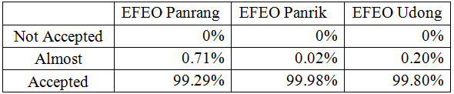
RESULTS
The three Cham fonts:
EFEO Panrang (99.28%)
EFEO Panrik (99.98%)
EFEO Udong (99.80%)
Table 8. The Cham font survey results
Back

Slide 17
CONCLUSIONS
Cham fonts have design based on Unicode and using for both Macintosh and Windows platform.
Cham fonts: EFEO Panrang, EFEO Panrik, EFEO Udong are easy to use and the Cham font size similar to Times New Roman.
These Cham fonts to bring significant benefits for the Cham community and will be useful in learning and teaching the Cham language.
Back

Slide 18
Thanks for listening
Terima kasih
t-r[m ks[H
t-r[m ks[H
t-r[m ks[H
Next

Slide 19



Prof.Dr. Mohamad Bin Bilal Ali
Dr. Noor Dayana Abd Halim
PhD. Mohamad Budi
University Technology Malaysia (UTM)- Malaysia
Back

